Slide 1
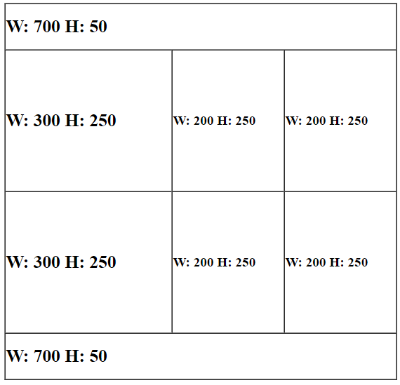
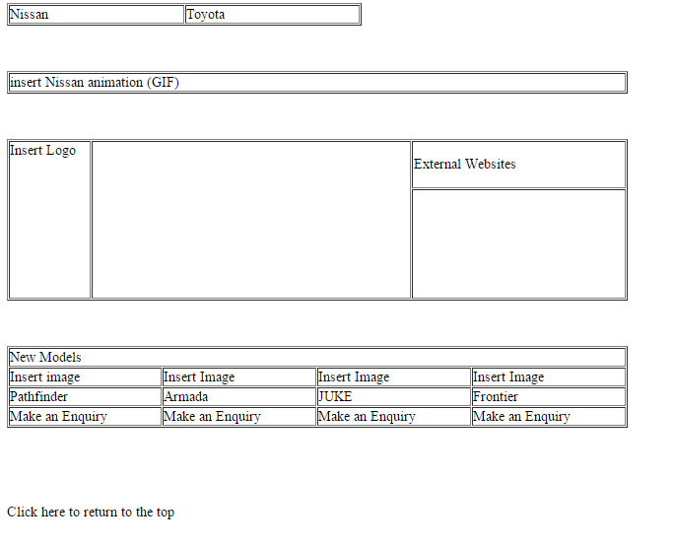
Open the Nissan.html page in a suitable application and create the table shown below between Table 3 and 4. Set the appropriate sizes for each cell.
A
Table 1
B
C
D
Table 2
Table 3
E
F
G
Table 4
H

Slide 2
2. Insert the following content into the new table: Cell A: Welcome to the Nissan Homepage (H1) Cell B: Nissan Motor Company Ltd, usually shortened to Nissan, is a Japanese multinational automobile manufacturer headquartered in Nishi-ku, Yokohama. (P) Cell C: Car 1.JPG Cell D: Car 2.JPG Cell E: Car 3.JPG Cell F: Car 4.JPG Cell G: Car 5.JPG Cell H: Come to any of our dealers for a test drive on any of our models. (H2) 3. Make sure that appropriate text is displayed if the images are not available. 4. Apply text styles shown.

Slide 3
5. Create a new stylesheet called text style using the most efficient syntax. H1, H2, H3: Arial, Helvetica, sans-serif, Bold, Italic and 22pt H1: Red, Centre aligned H2: Blue, Left Aligned H3: Dark Red Unordered list: Square bullet points. Body: Yellow 6. Create a new stylesheet called table style using the most efficient syntax. Table, TD: Solid Borders, 2 pixels width, Red Table: Cell Padding 10 pixels, Grey background and all borders collapsed. Include your name as a comment on both style sheets (/*name*/).

Slide 4
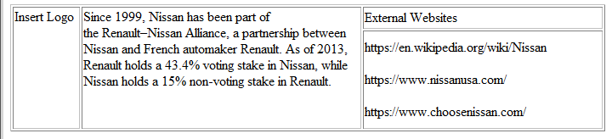
7. Attach the stylesheets created in step 5 and 6 to both html pages. 8. Insert a suitable animation in table 2 for both webpages. You will have to export the animation file in a suitable format before you import into Dreamweaver. 9. Insert a suitable logo into table 3 for both webpages. 10. Create external links to open on a new window. 11. Apply the text styles shown below.
P
UL

Slide 5
12. On the Nissan webpage insert suitable images to replace the text Insert Image in the New Models table. Make sure that appropriate text is displayed if the images are not available. 13. Create an email link to Make an Enquiry to nissan@gmail.com with a subject line: Test Drive (insert name of car). 14. Apply the H3 style to all text in the New Models Table. 15. Make the text Click here a hyperlink to return to the top of the page for both webpages. 16. Set suitable titles for each web page. 17. Create internal links between the two webpages. 18. Embed a CSS style to centre align all tables.

Slide 6
19) Create a test table to carry out suitable tests on your website. You can also test the following: External links, Email Links, Named anchors, images appearing, correct text styles applied.
Test | How | Expected | Actual | Action Taken
Checking internal Hyperlinks | Click on each link in the browser | All links to go to the correct page. | All links work as expected. | No action required.

